Slide 1
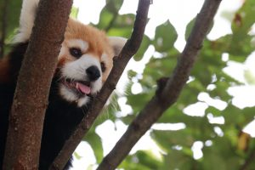
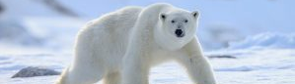
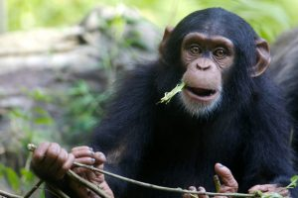

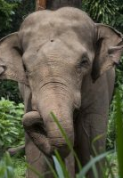
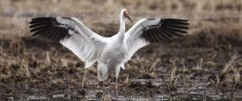
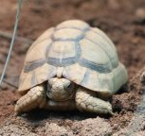
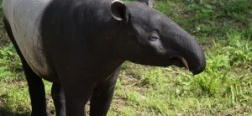
Endangered Species
By Yuto Watanabe July 2022
Photos :https://myethicalchoice.com/journal/climate-change/endangered-species/#1
Notes:
Hello, everyone I’m Yuto Watanabe.
Today, I’m going to talk about “Endangered Species”

Slide 2
Table Of Cntents
1, Iriomote Cat (JPN):Iriomoteyamaneko
2, Acilius Kishii (JPN):Yasyagengorou
Japanese endemic species
Notes:
I’m going to present two species of animals.
The first is Iriomote Cat, the second is Acilius Kishii, and their respective Japanese names are Iriomoteyamaneko and Yasyagengorou.
Both of they are Japanese endemic species

Slide 3
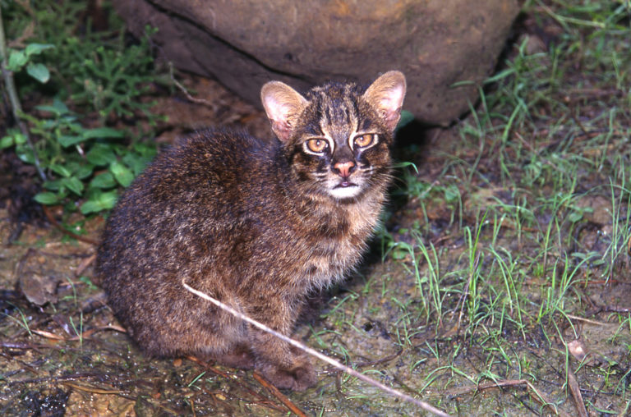
1,Iriomote Cat
Habitat: only Iriomote Island, Okinawa
Population: About 100
（estimated）
Body length: 50 to 60 cm
Weight : 3 to 5 kg
Photo documents httpｓ://myethicalchoice.com/journal/climate-change/endangered-species/#1
Notes:
First, Iriomote Cat.
It lives only in Iriomote Island, Okinawa, and its population is about 100.
And Body length is 50 to 60cm.
They weigh 3 to 5 kg

Slide 4
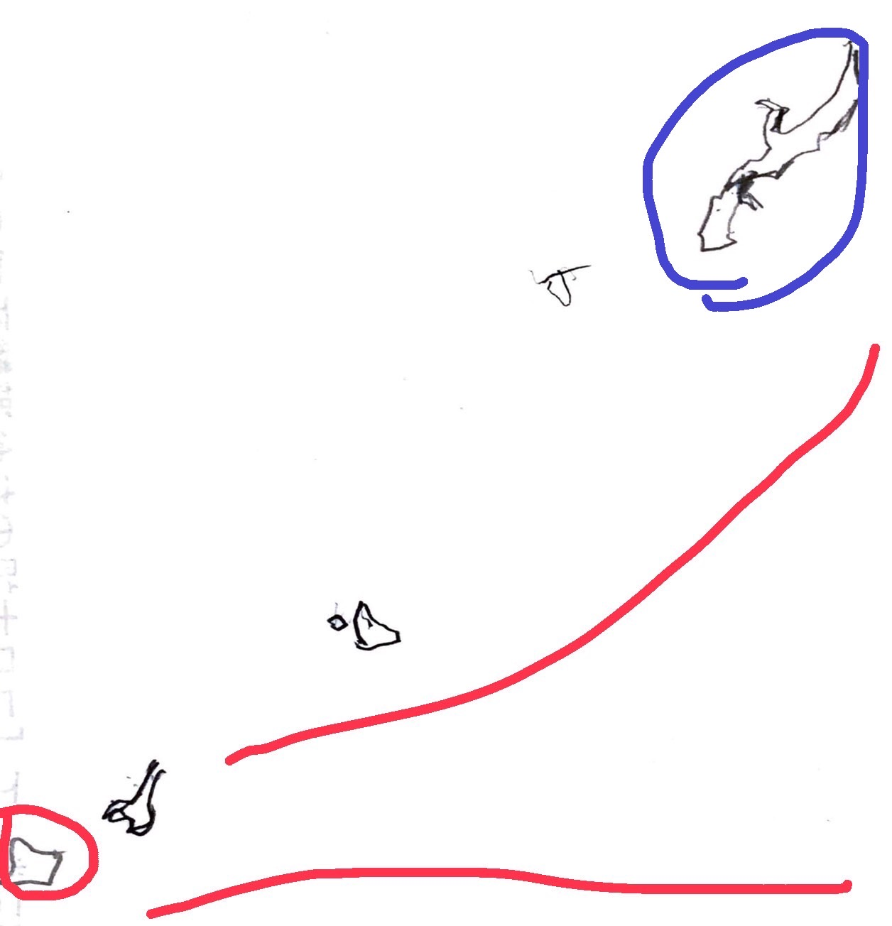
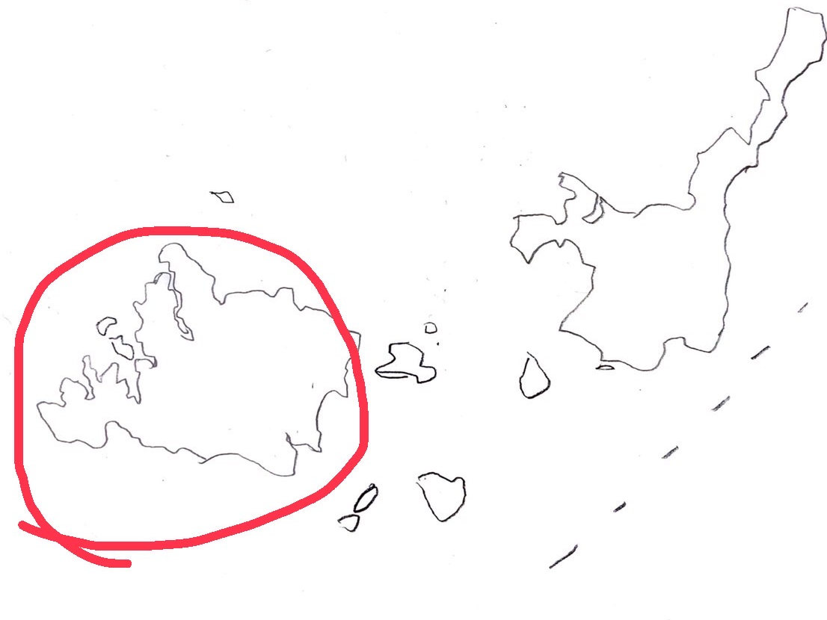
Details(Iriomote Cat)
Location(Iriomote Island)
Iriomote Okinawa main island
Reason for decrease
Main :Traffic accident
Because of…
the development of
the car society
Notes:
Let me explain in more detail.
Look at this picture.
The blue circle is Okinawa main Island and the red circle is Iriomote Island.
The main reason for the decrease of Iriomote Cat is traffic accidents. The development of car society is the cause

Slide 5
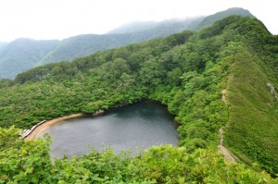
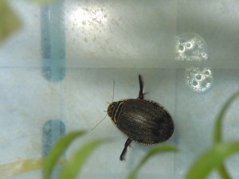
2, Acilius Kishii
Habitat: Yasyagaike(Echizen in Fukui)
Border of Fukui and Gifu
Size: 14.5 to 16.0 mm
Photo: https://fncc.pref.fukui.lg.jp/reference/currentinvestigation/yashagengoro
Notes:
Second, Acilius Kishii.
It lives in Yasyagaike, Echizen in Fukui.
Japanese name “Yasyagengorou” comes from Yasyagaike.
The size of them is 14.5 to 16.0mm

Slide 6
Details(Acilius Kishii)
Reason for decrease
1, Water pollution
Increase in climbers and tourists
2，Illegal capture 3，Habitat is small
Incidentally,…… Fukui City is breeding them.
document：https://www.env.go.jp/nature/kisho/hogozoushoku/yashagengoro.html
Notes:
To explain a little more, here are the reasons of decrease of them.
First, Water pollution. Because of increase in climbers and tourists.
Second, Illegal capture.
Third, Habitat is small.
By the way, Fukui City is breeding them.

Slide 7
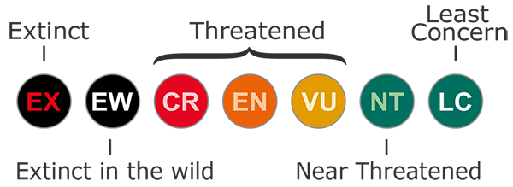
Extinction Risk
LEVEL
figure：https://www.clearias.com/iucn-classification-critically-endangered-endangered-and-vulnerable/
CR
EN
Photos httpｓ://myethicalchoice.com/journal/climate-change/endangered-species/#1
https://fncc.pref.fukui.lg.jp/reference/currentinvestigation/yashagengoro
Notes:
By the way, There are several levels of extinction.
EX is completely extinct. EW is wild extinct. CR is the most Endangered species.
Iriomote Cat is CR. Acilius Kishii is EN.
I hope their number increase.

